Slide 1
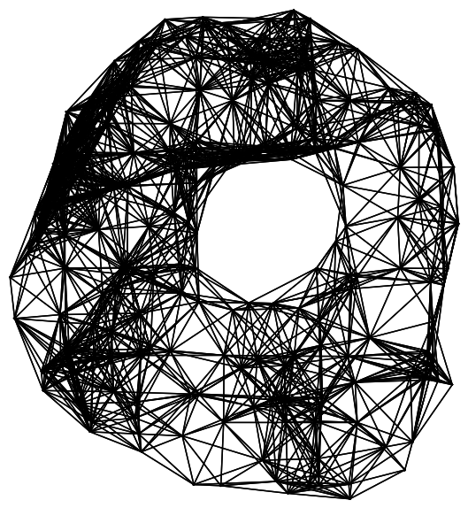
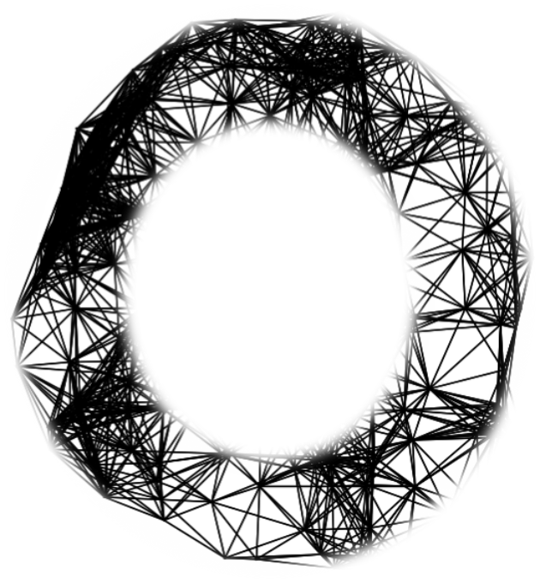
Computation of Persistent Homology Using the Delaunay-Rips Complex
An efficient family of simplicial complexes
for topological data analysis
Amish Mishra and Francis Motta

Slide 2
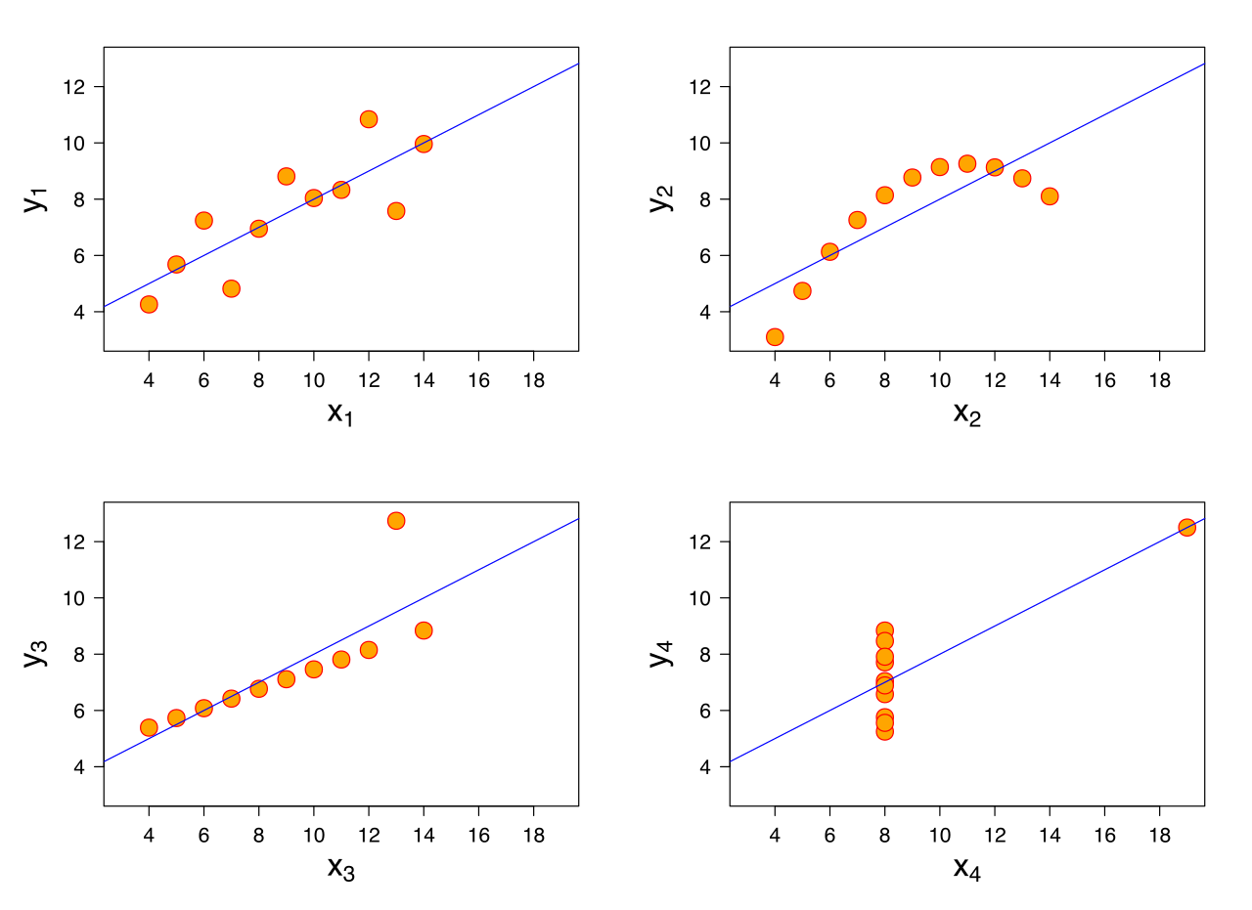
Anscombe’s Quartet
Notes:
Similar mean of x, y, sample variance of x and y, correlation, linear regression, R^2

Slide 3
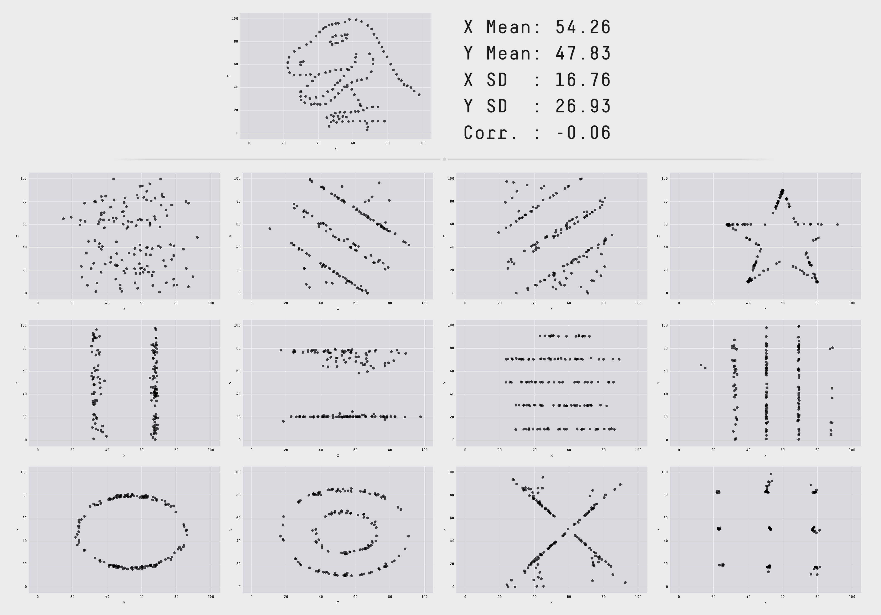
The Datasaurus Dozen
Notes:
https://www.autodesk.com/research/publications/same-stats-different-graphs

Slide 4
Problem

Slide 5
Problem
What if visualization is not an option?

Slide 6
TDA

Slide 7
TDA (Topological Data Analysis)
Quantify the qualitative features of data for computation and interpretation

Slide 8
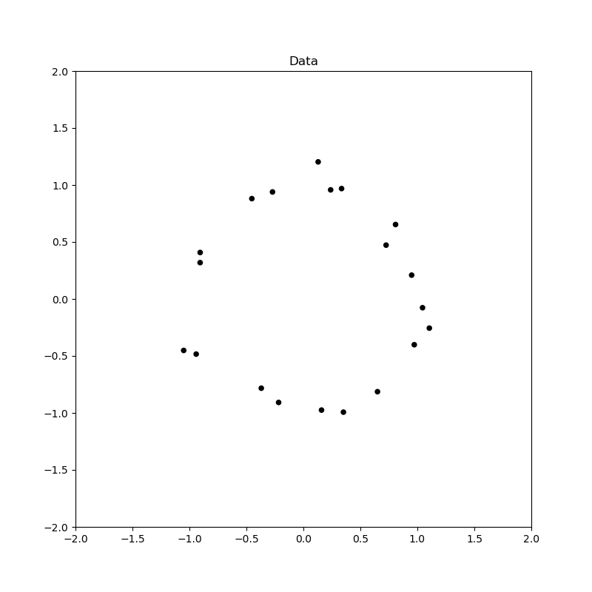
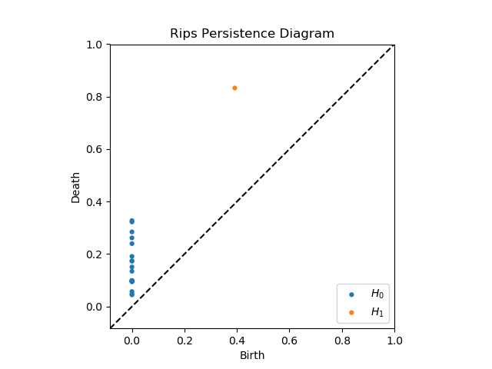
TDA (Topological Data Analysis)

Slide 9
TDA Applications
Protein folding video
Mobile data: https://epjdatascience.springeropen.com/articles/10.1140/epjds/s13688-015-0041-5
Brain arteries:
https://cdr.lib.unc.edu/concern/parent/c534fv18f/file_sets/ft848x10p
Notes:
PersGNN Krishnapriyan

Slide 10
Pipeline
Data -> Complex -> Persistence Diagram -> Interpretation

Slide 11
Buzz words
Data/Point cloud
picture

Slide 12
Buzz words
Complex/Topology
Picture

Slide 13
Buzz words
Persistence Diagram/Geometric Features
Picture of PD with complex to show correspondence

Slide 14
Main question:
Can we do it faster?

Slide 15
Rips

Slide 16
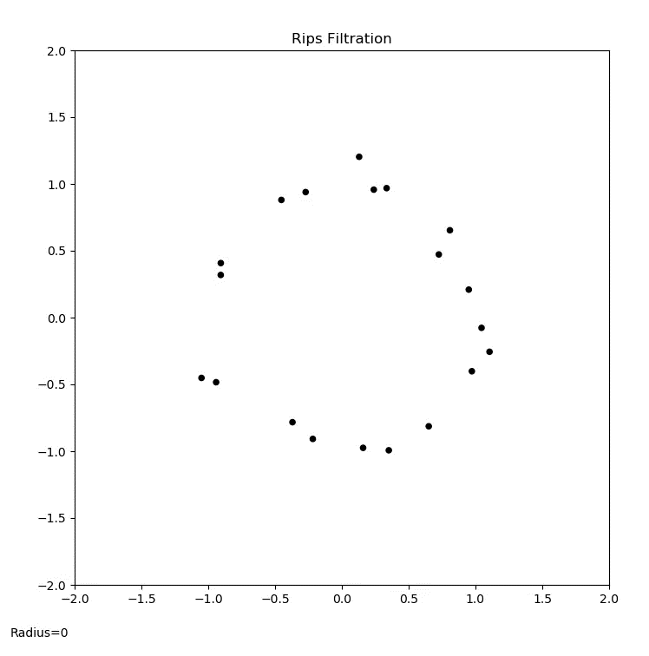
Rips animation

Slide 17
PD Interpretation

Slide 18
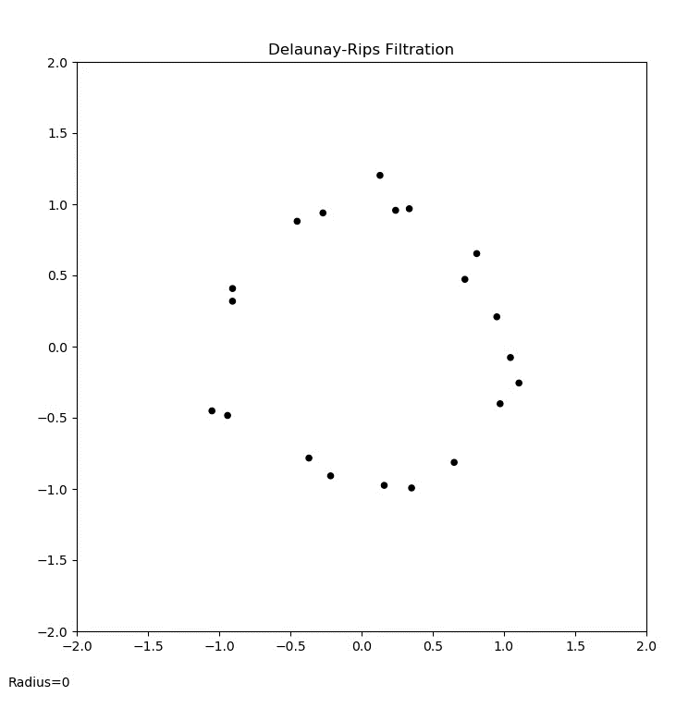
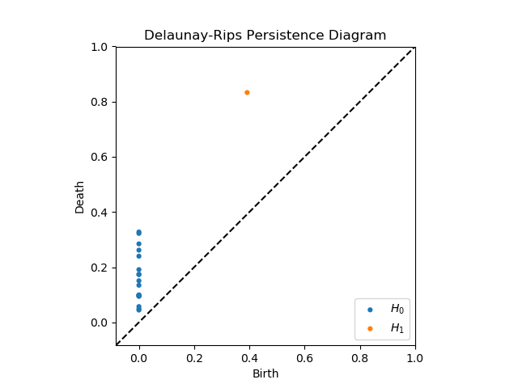
Del-Rips animation

Slide 19

PD Interpretation

Slide 20
Persistence diagram comparison

Slide 21
Run-time comparison

Slide 22
Synthetic Data application

Slide 23
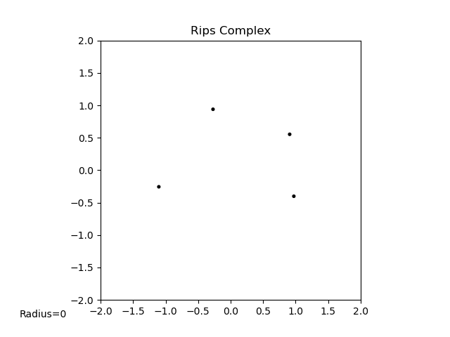
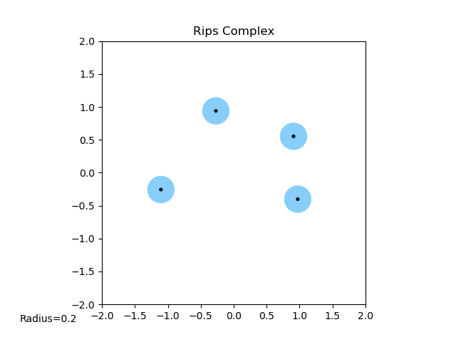
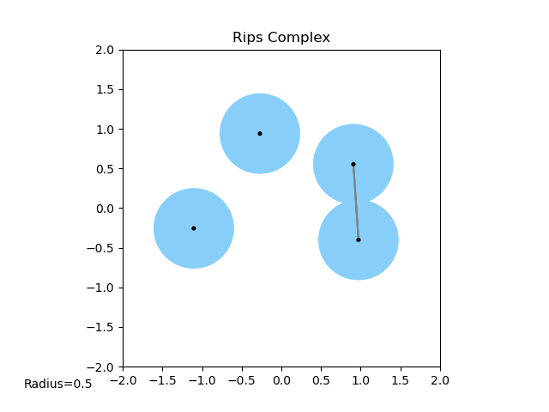
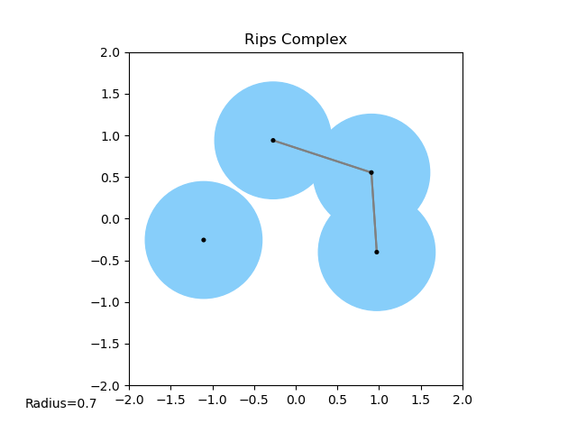
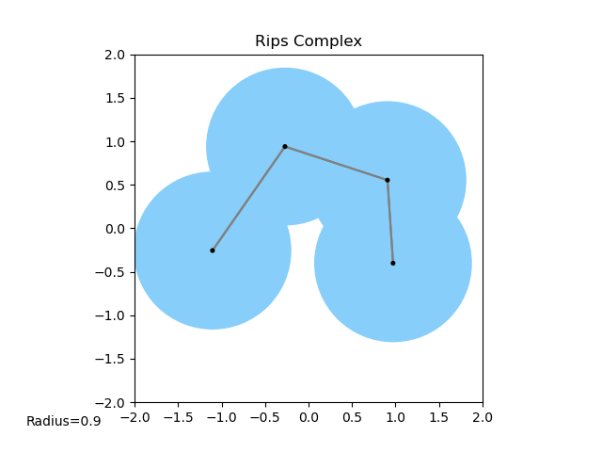
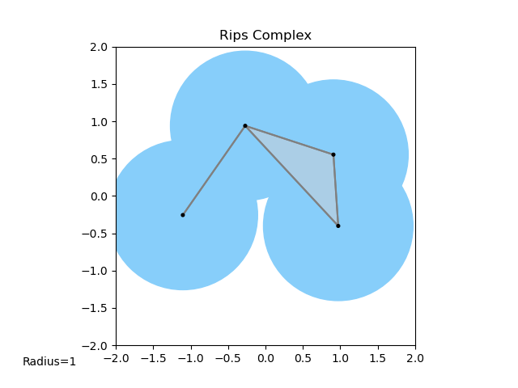
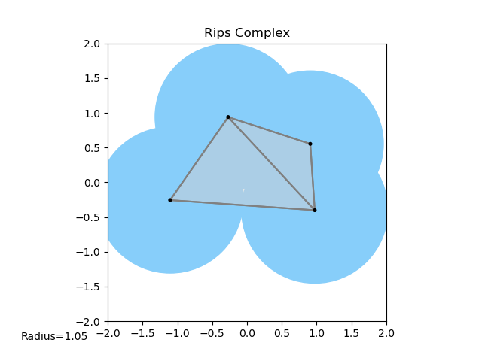
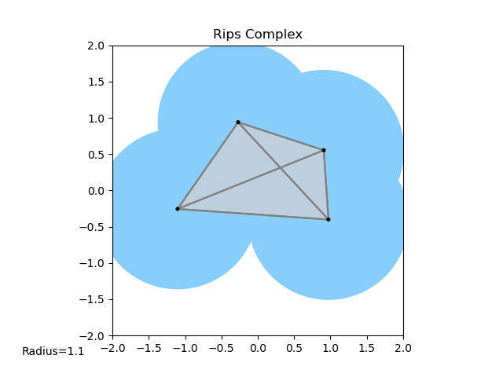
Definition of Rips

Slide 24
Definition of Delaunay Triangulation

Slide 25
Definition of Delaunay-Rips complex

Slide 26
Definition of filtration

Slide 27
Algorithm for building filtration

Slide 28
Question: How stable is this?

Slide 29
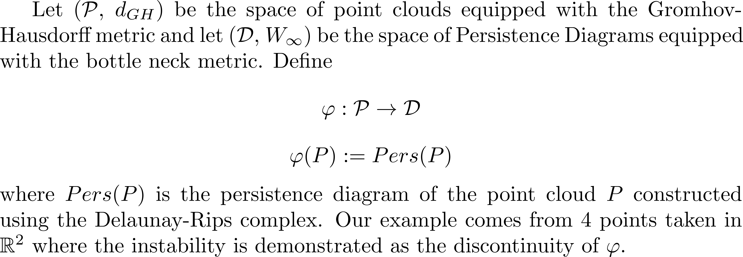
Math behind instability

Slide 30
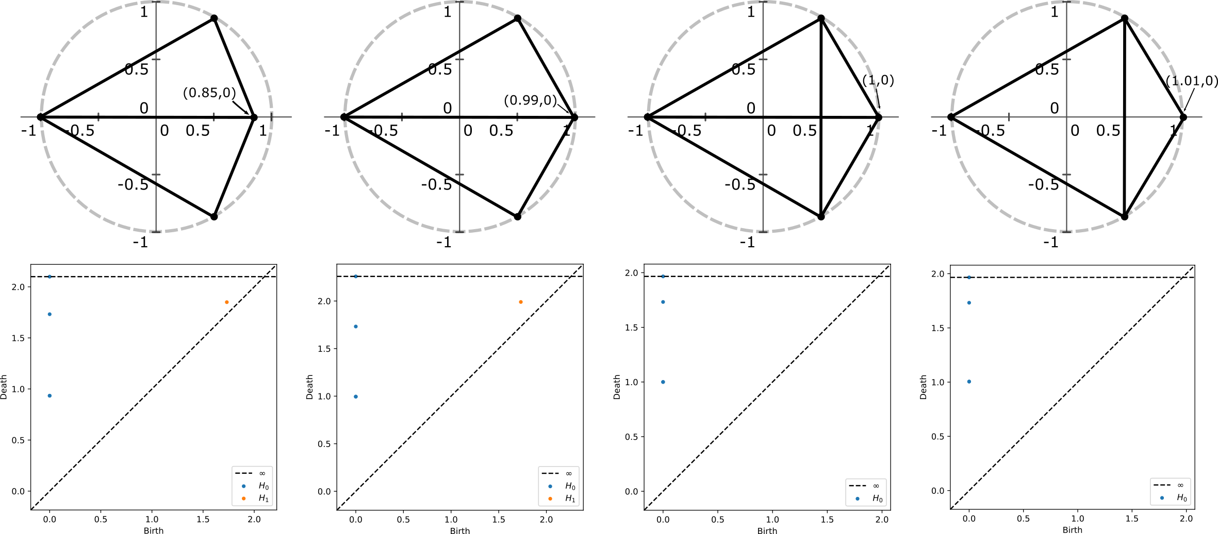

Slide 31
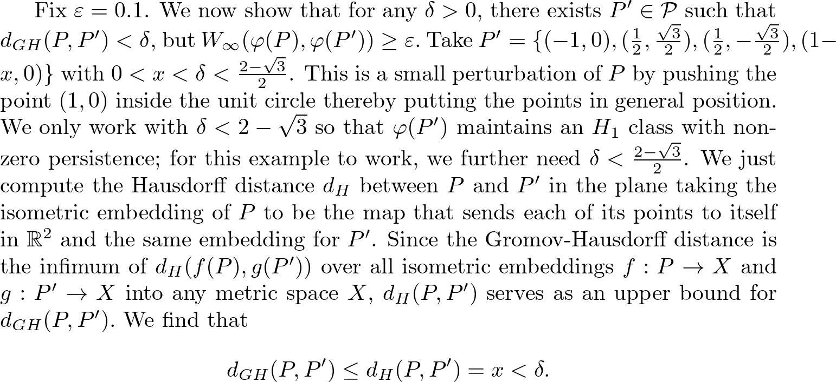

Slide 32
Visual 4 pt example of instability

Slide 33
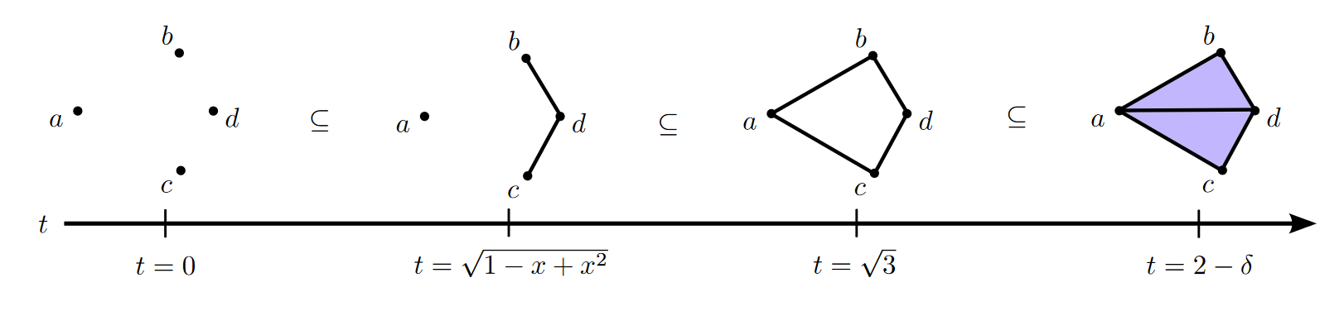
Aside

Slide 34
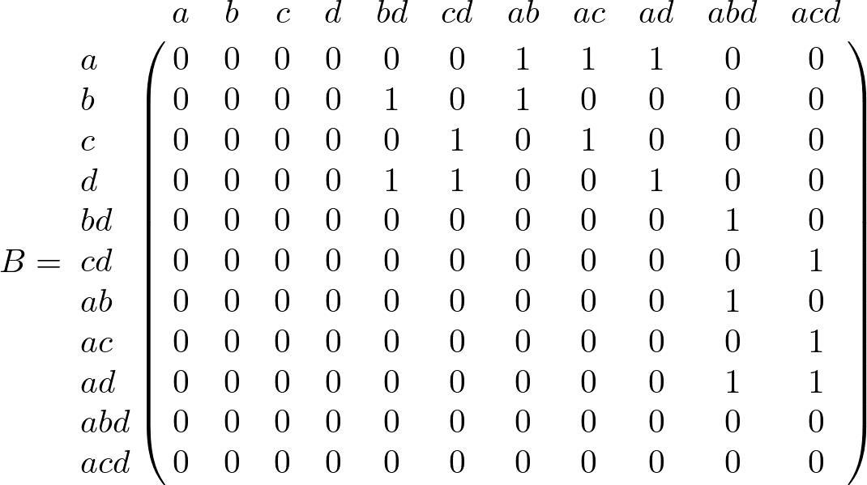

Slide 35
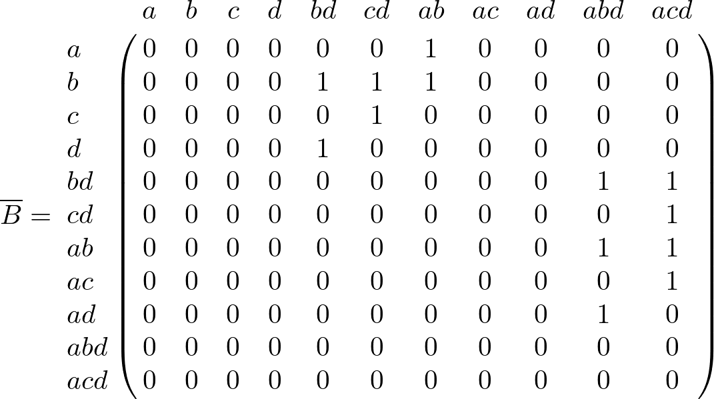

Slide 36
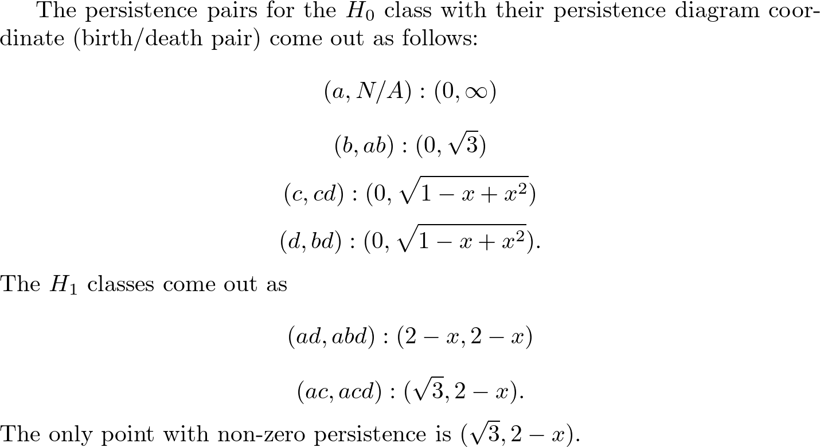

Slide 37
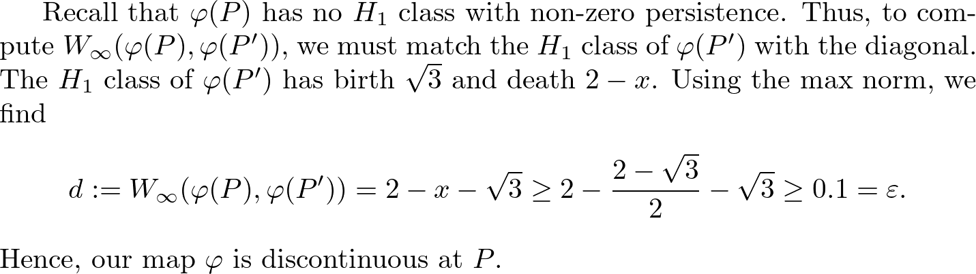

Slide 38
Conditions that guarantee stability
Theorem
Lemmas
Ideas behind lemma
Visuals of circumcenter moving and causing edge-flips in triangulation
Show when a Delaunay face exists and when it doesn’t
R^2 examples

Slide 39
Maintain Delaunay Triangulation!

Slide 40
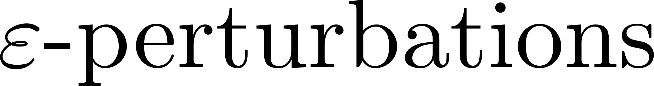
Existing work (Weller)

Slide 41
Apply to real data sets

Slide 42
Applications in ML

Slide 43
Proving stability for other TDA methods

Slide 44
Francis Motta

Slide 45
FAU

Slide 46
JMM

Slide 47
References

